Slide 1
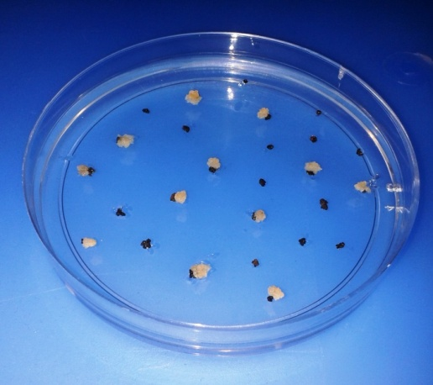
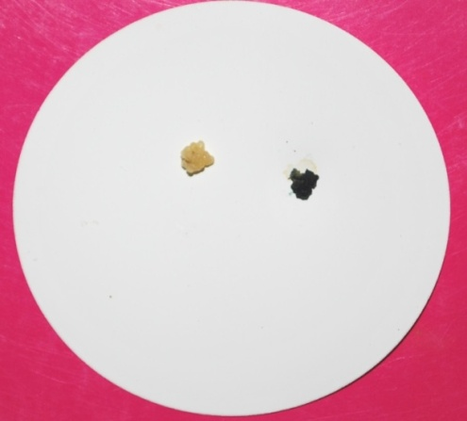
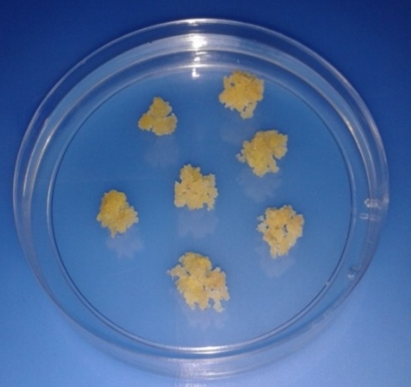
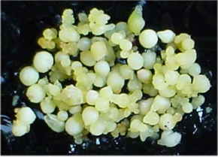
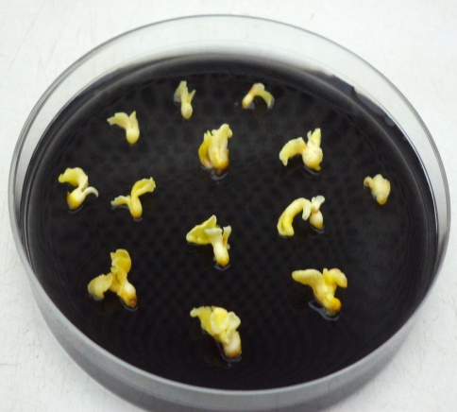
Initiation and proliferation of transgenic callus
A
B
C
Fig. 3. A. Emergence of putatively
transgenic callus (yellow color)
Fig.3 B . GUS histo-chemical
staining (blue color)
Fig. 3.C. Transgenic embryogenic callus
Transgenic plant regeneration through somatic embryogenesis
B
A
Fig. 4.A Emergence of somatic embryos
Fig. 4. B. Cotyledonary stage embryos

Slide 2
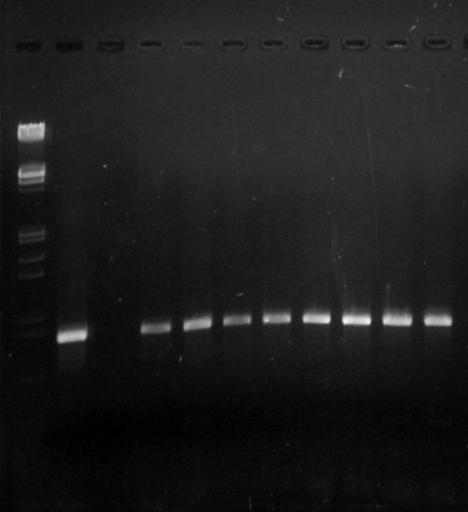
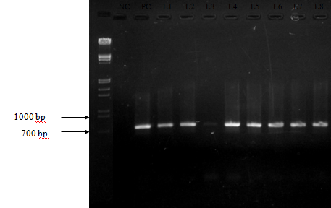
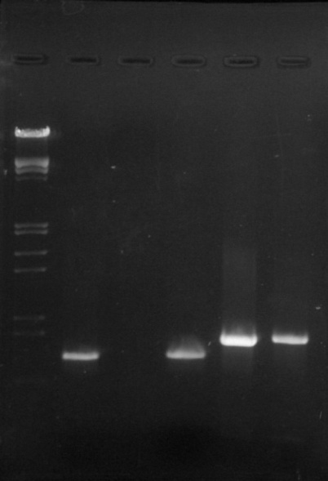
Molecular confirmation of multiple gene integration in Hevea callus
MM NC PC L1 L2 L3 L4 aa L5 L6 L7 L8
MM NC PC L1 L2 L3 L4 L5 L6 L7 L8
MM PC NC L1 L2 L3 L4 L5 L6 L7 L8
21 kb
21 kb
MM PC NC L1 L2 L3 L4 L5 L6 L7 L8
21 kb
21 kb
A
B
Fig. 5. A. PCR amplification with npt II gene specific primer
Fig. 5. B PCR amplification with MnSOD gene specific primer
MM PC NC L1 L2 L3 L4 L5 L6 L7 L8
MM PC- UC PC nptIi nptII
SOD SOD T-SOD PC- Test
21 kb
21 kb
600 kb
700 kb
800kb
A
B
Fig. 6. A. PCR amplification with hpt gene specific primer
Fig. 6 B. PCR amplification with MnSOD and nptII gene specific primers

